Slide 1
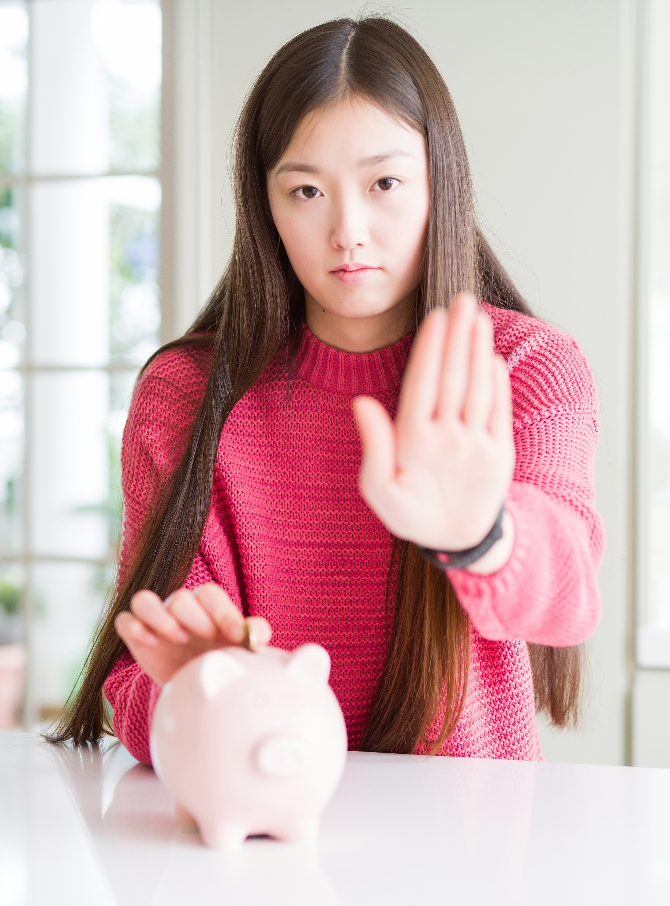
115.113 Lecture 1
Economics For Business

Slide 2
Administration
Checklist
Sign up for workshops if you haven’t already.
Attend 1 Workshop each week
Quiz 1 is open
  Closes 28 July
  Covers Unit 9 and 13

Slide 3
Outline
Readings
Key Ideas
Tasks
13.1 to 13.5
13.8
GDP
Business Cycle
Inflation
Okun’s Law
Readings
Attend lecture
Attend workshops

Slide 4
Maths Revision
Linear Line

Slide 5
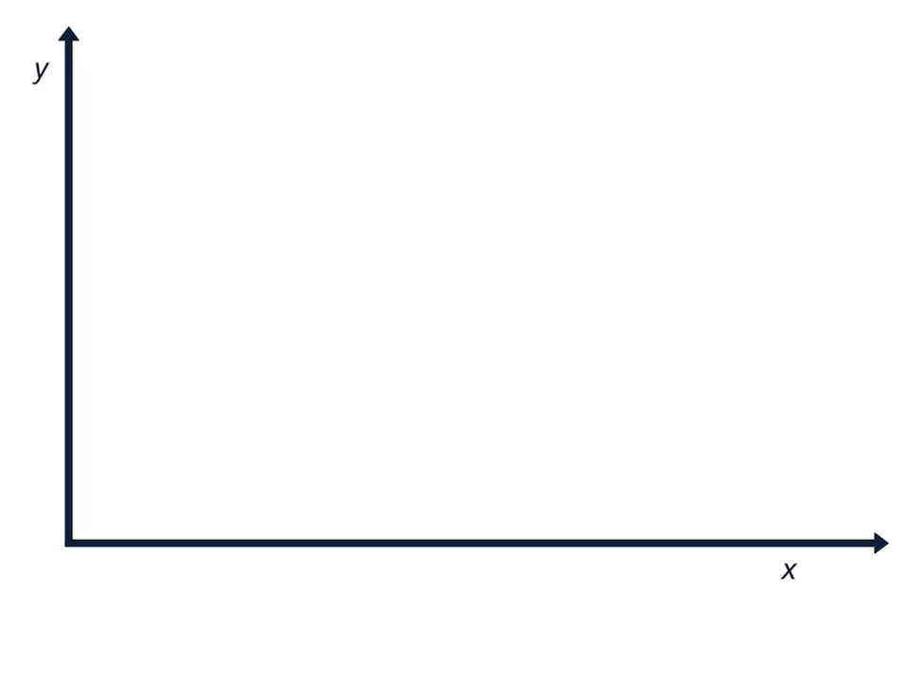
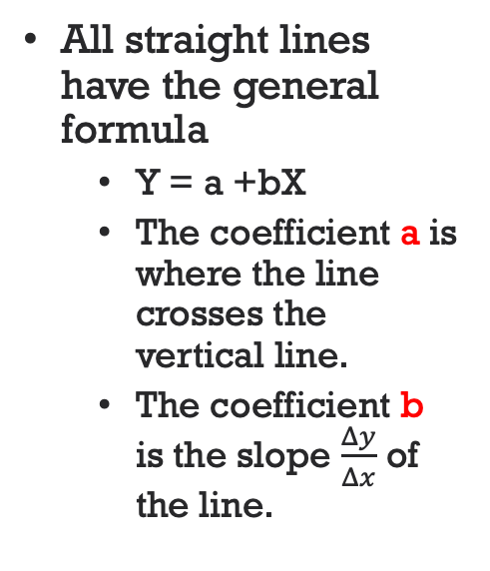
Linear Equation
All straight lines have the general formula
  Y = a +bX
  The coefficient a is where the line crosses the vertical line.
  The coefficient b is the slope $\frac{Δy}{Δx}$ of the line.

Slide 6
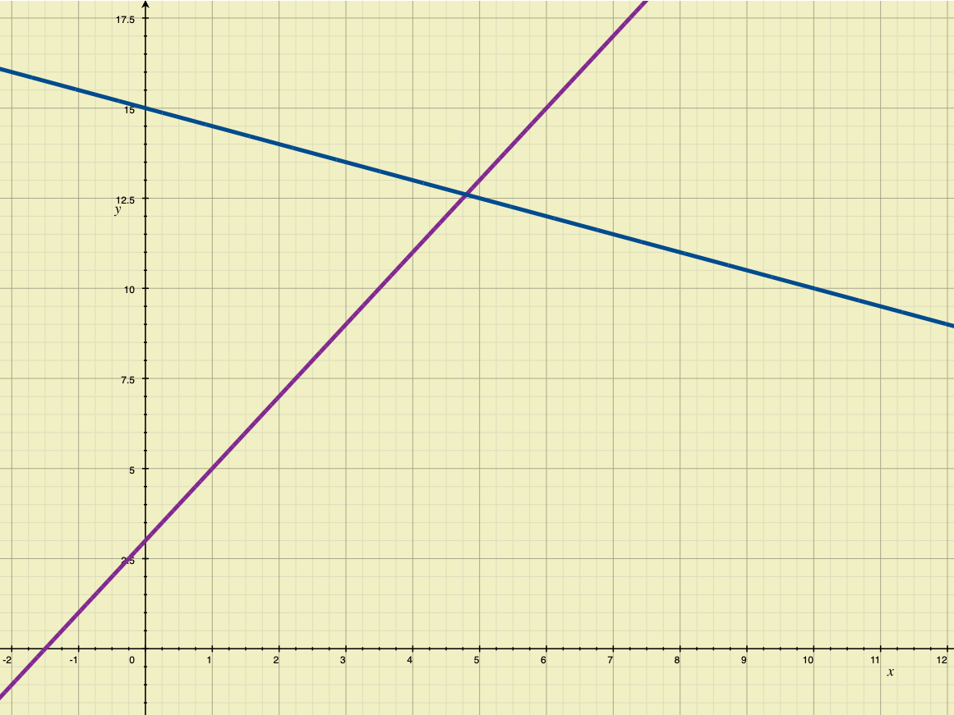
Examples
y = 3 + 2x
y = 5 + 0.1x

Slide 7
GDP

Slide 8
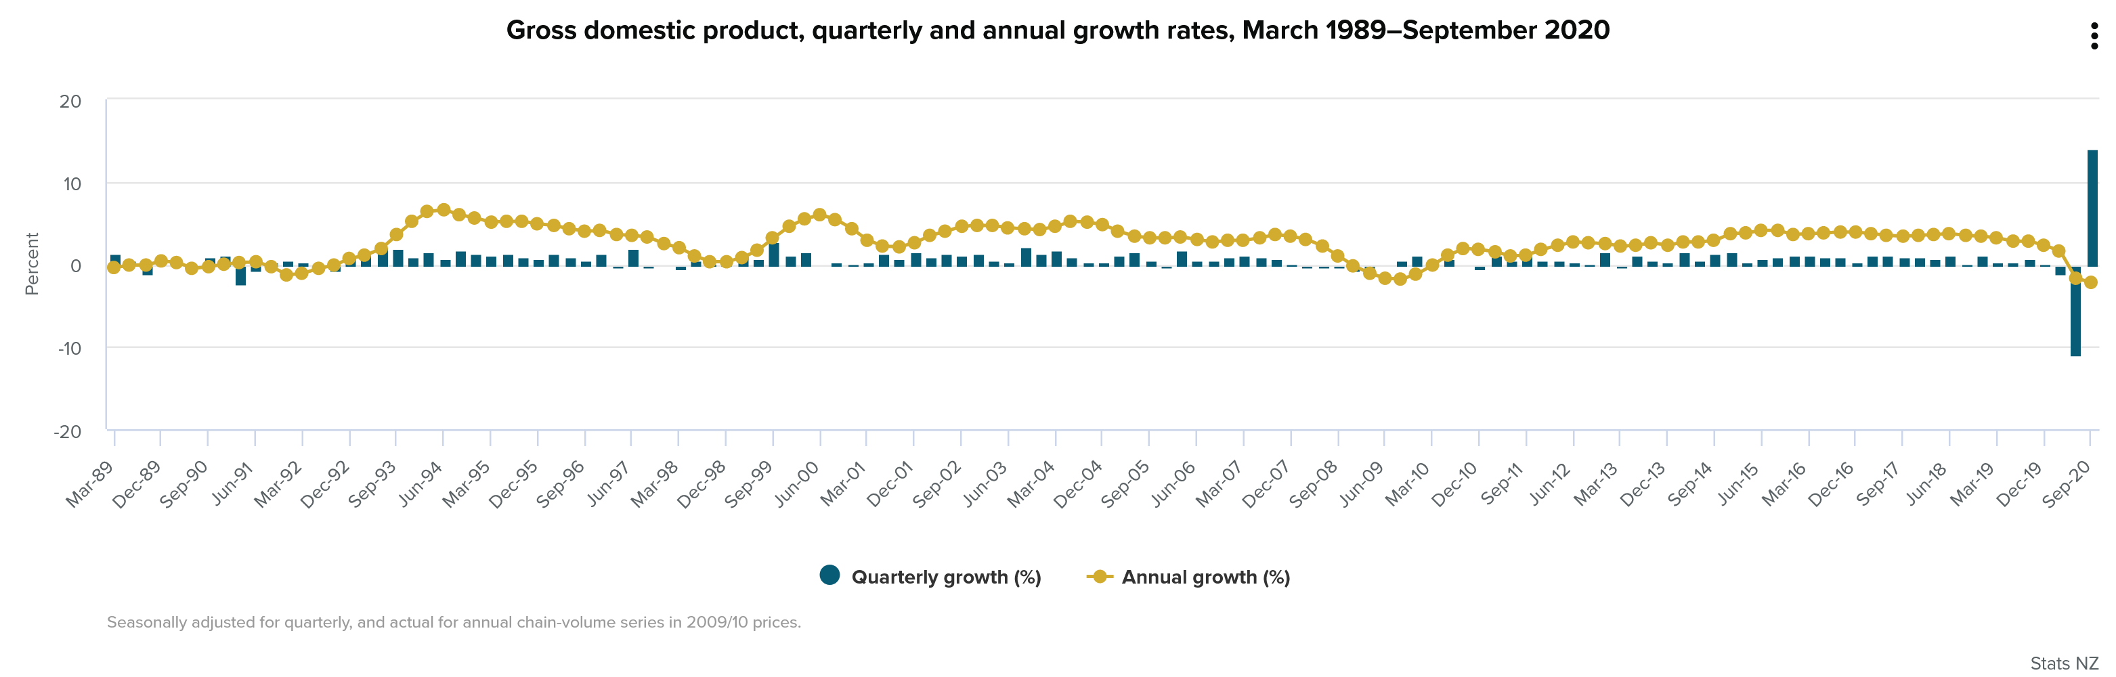
NZ GDP
Like all economies NZ economic growth fluctuates- some shocks cause it to be negative.

Slide 9
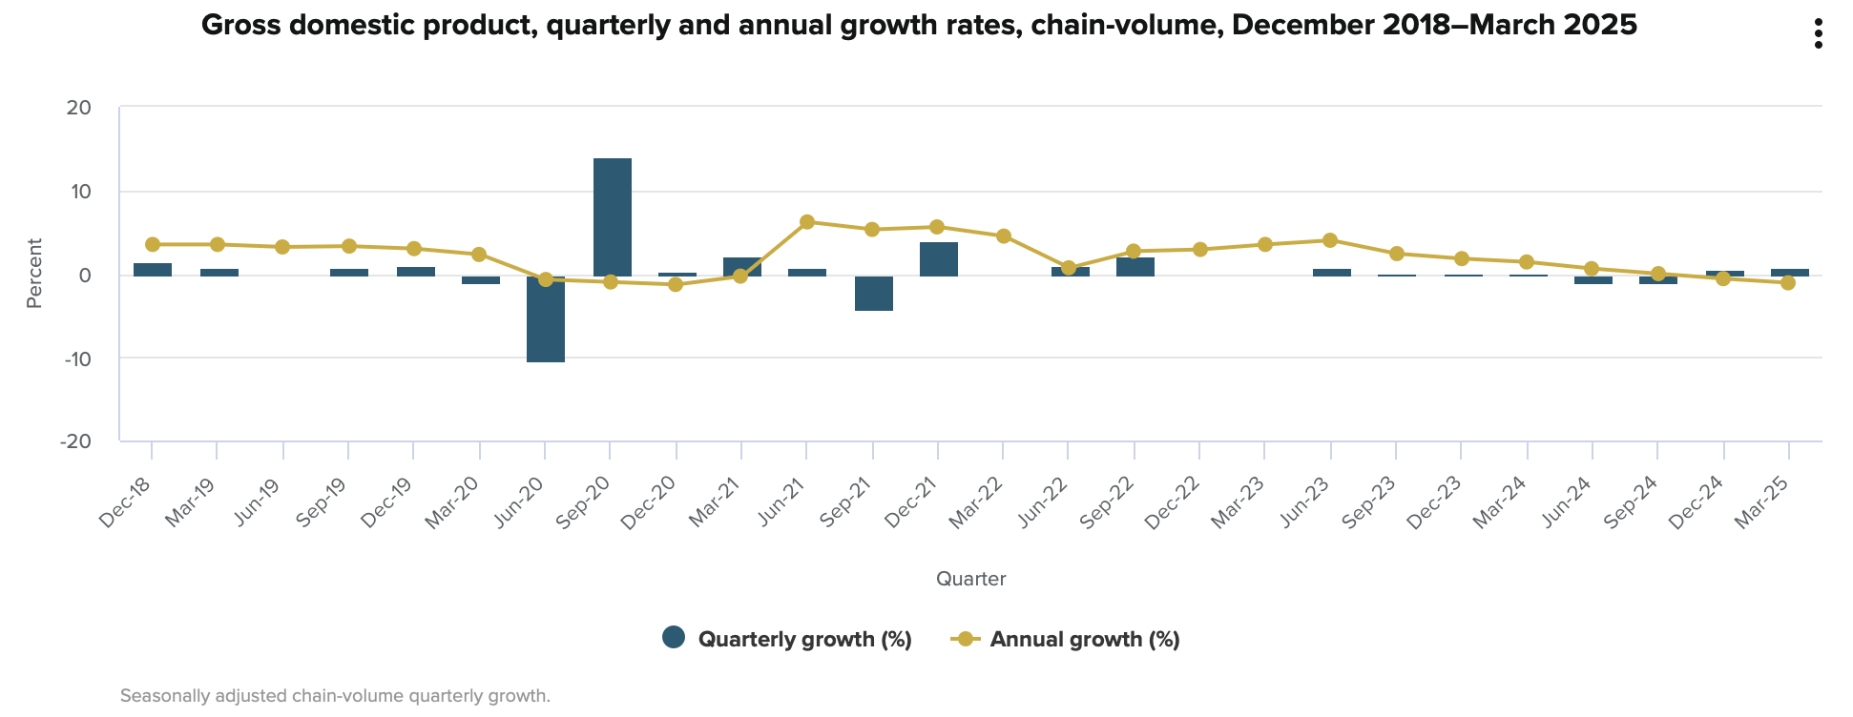

Slide 10
Two Key Ideas
GDP
This measures economic activity in a country
It is the market value of the output of the economy in a given period
Business Cycle
Alternating periods of faster or slower growth.
Recessions occur when growth is negative (or below normal level)

Slide 11
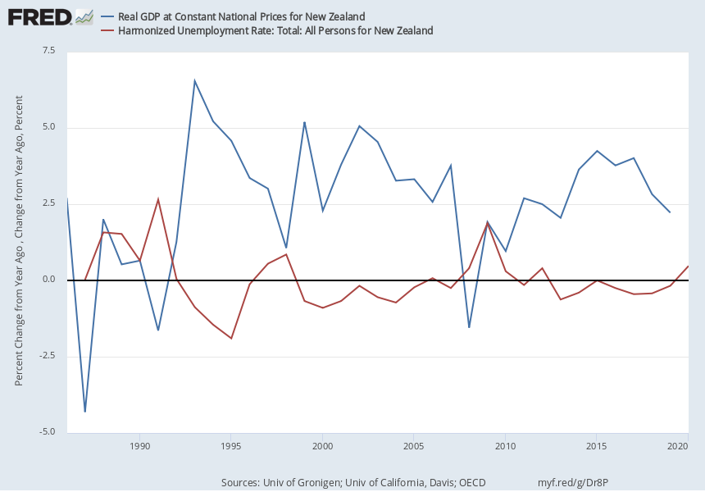
Why Recessions matter
The business cycle affects labour markets.
Unemployment rises during recessions and falls during booms.
Unemployment is costly

Slide 12
Why is Unemployment Costly?
Households face an income shock.
Unemployed also face higher levels
  of stress
  Unhappiness, loss of self-esteem
Clark and Oswald showed average unemployed person would
  need £15,000 per month to restore welfare to employed-level.
  Average wages were £2,000 per month.
Cost to society greater than loss of wages or salary.

Slide 13
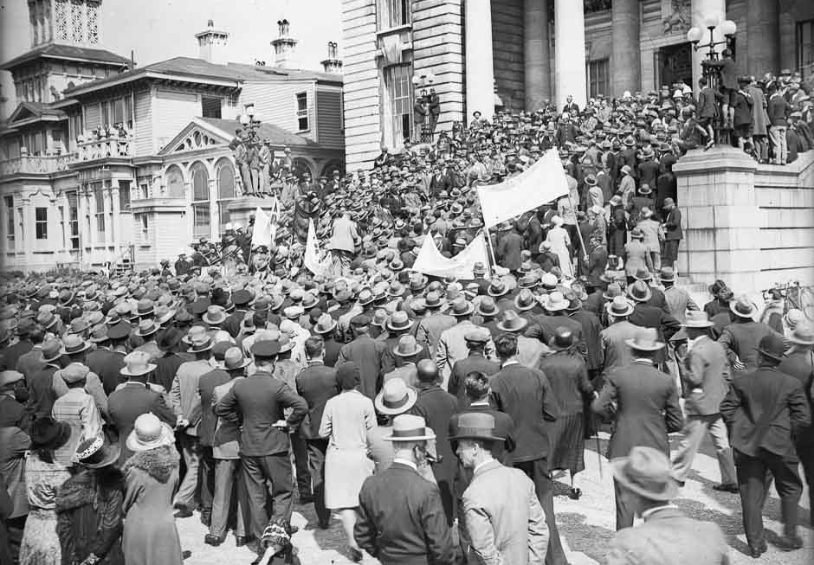
Great Depression
During Great Depression high unemployment led to civil unrest, protests and riots.

Slide 14
Output and Unemployment
02
Okun’s Law

Slide 15
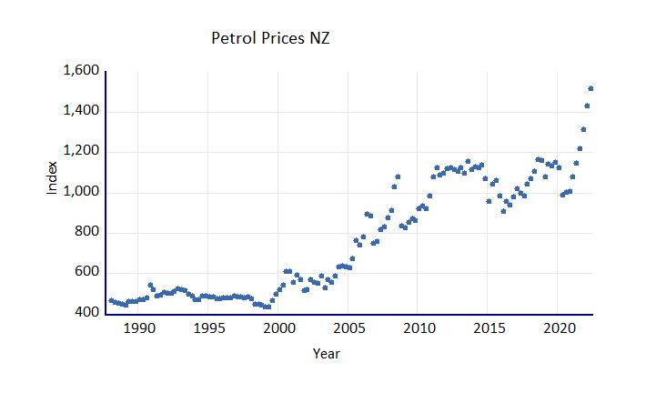
Scatter Plots: Revision
Economic data can be graphed as a scatter-plot.
We can add a line of ‘best-fit’ to the data.

Slide 16
Line of Best fit
The line of best fit is a linear line.
  It can be defined in terms of the intercept and slope
    y = ax + b
  Or because of commutative rule
    y = b + ax
The line’s fit is measured as the R² value
  0 implies no statistical fit
  1 implies a perfect statistical fit.
If the best fit is a straight-line, it is (usually) estimated by a least-squares technique.

Slide 17
The slope of the line for an equation relating the change in unemployment to the change in GDP
Okun’s Coefficient

Slide 18
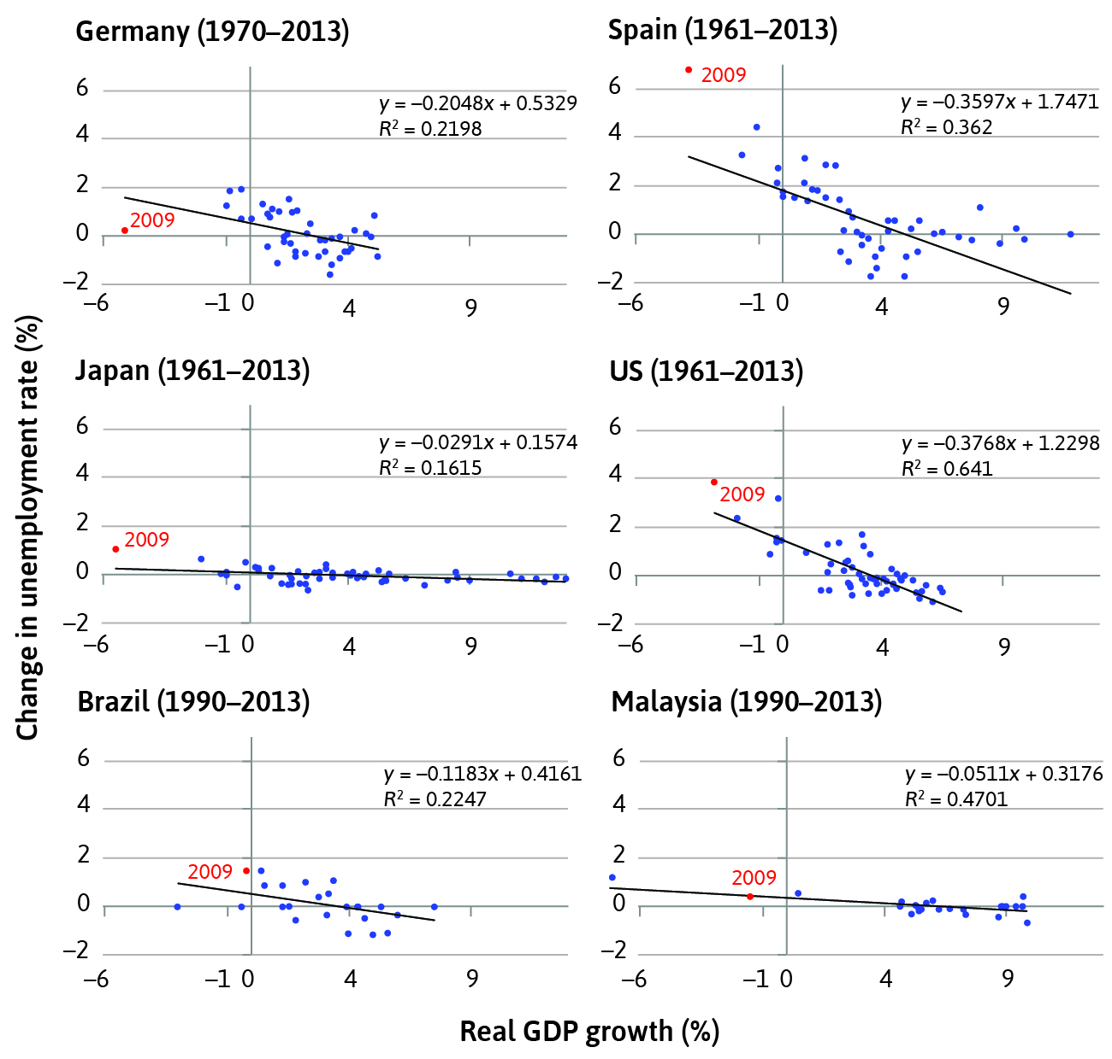
Okun’s Law
Okun coefficient is the slope 𝚫y/𝚫x of the lines.
Okun’s law states it will be negative.
Example: Germany is -0.2048
  Thus a 1% increase in GDP will change unemployment by -0.2048%

Slide 19
Okun’s Law
Changes in the rate of GDP growth are negatively correlated with the unemployment rate.
If output falls, unemployment rises
If output rises, unemployment falls
Okun’s Law is the strong and stable relationship between unemployment and GDP growth

Slide 20
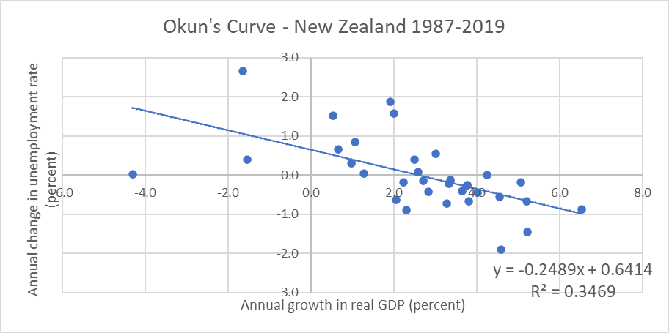
Okun’s Law – New Zealand
What is the vertical intercept?
What is Okun’s coefficient?
  If GDP falls by 4.8%, what is the predicted change in unemployment?
Predicted change in unemployment = 0.6414 + (-0.2489 x -4.8)
= 1.84 percentage points (increase)

Slide 21
Measuring the Aggregate Economy
02
Gross Domestic Product (GDP)

Slide 22
Origin of GDP
Before World War 2 (1939-1945) Governments could not measure the aggregate economy.
Hence could not
  Identify easily when economy was in recession
  Know what policies to implement
  Know when to implement these policies
  Know how much money they should borrow or spend.
This was a major problem in Great Depression (1929-1933)

Slide 23

Simon Kuznets
Simon Kuznets (Nobel Laureate) helped devise system of national accounts to measure aggregate economy.
Widely adopted as standard across all countries soon after.

Slide 24
While the GDP and the rest of the national income accounts may seem to be arcane concepts, they are truly among the great inventions of the twentieth century
Paul A. Samuelson and William D. Nordhaus

Slide 25
Basic Concept
Suppose Mei pays Sione $100 to paint her kitchen.
  Mei’s expenditure is $100
  Sione’s income is $100
In an economy, all expenditure ends up being someone else’s income.
In an economy, income and expenditure must equal.

Slide 26
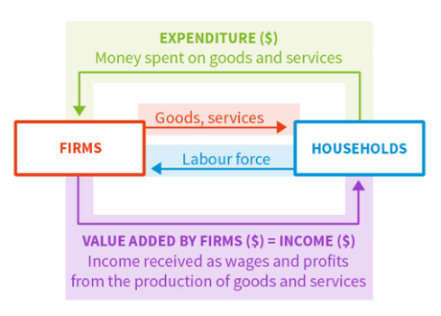
National Accounts
A system to measure overall output and expenditure in an economy.
It can be based on spending, production or income (see diagram).
In practice the expenditure approach is most widely used.

Slide 27
GDP
This measures the market value of all the goods and services produced in an economy over a set period.
Production can be done by either domestic or foreign nationals.
  E.g. a dairy factory operated by an NZ company in Australia counts toward Australia's GDP
  An Apple factory in China counts toward China’s GDP
Gross Domestic Product

Slide 28
International Transaction
Exports are added to our GDP
Imports are subtracted
Exports are produced here but consumed by foreign households
Imports are produced in another country but consumed here
These are goods
  either produced domestically (in NZ) but sold elsewhere
  Or
  Produced elsewhere but sold domestically (in NZ)

Slide 29
Government
Government spending on goods and services are added to GDP
Governments are like another producer of goods and services.
These are paid through taxes, not markets, at point of consumption

Slide 30
GDP
GDP is a measure of overall economic activity in an economy
It informs fiscal policy (Government) and monetary policy (Central Bank)
It does not measure welfare or well-being in an economy.
Other metrics, like the Human Development Index (HDI) are preferred.
What does GDP measure and not measure?
Find latest HDI data on web. Which country is ranked first? Where are NZ and the US ranked?

Slide 31
GDP problems
GDP only measures recorded market activity.
It does not measure the value of goods and services provided voluntarily.
It does not measure the value of goods and services produced illegally.

Slide 32
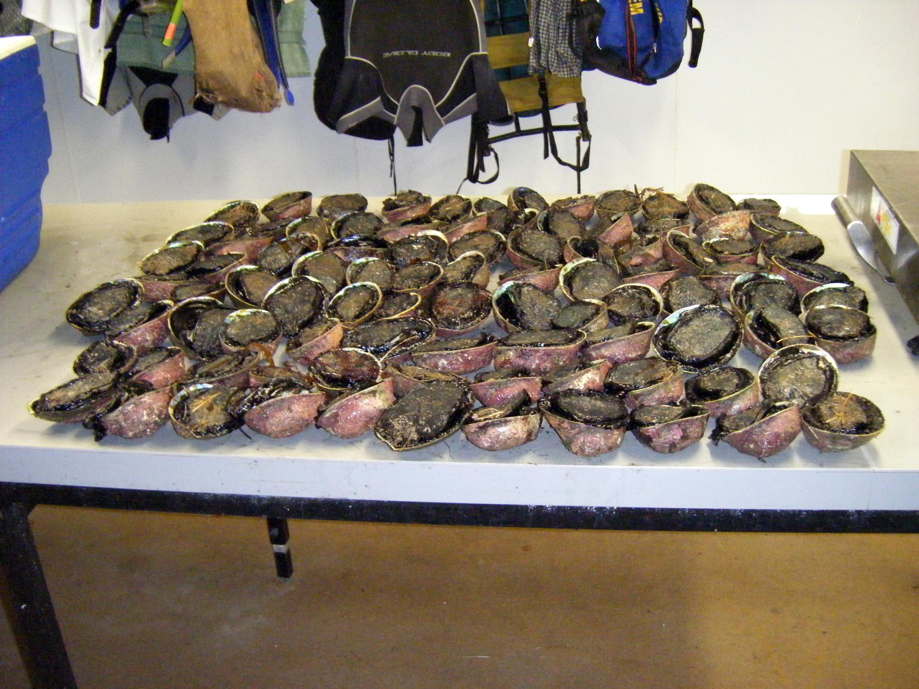
GDP problems
Example 1
  Walter harvests some paua illegally and sells them to Jesse for $100.
  Goods are still produced.
  Walter receives income
  Jesse spends money
  Transaction is not recorded

Slide 33

GDP problems
Example 2
  Jenny spends an hour each week ironing clothes.
  She then decides to pay someone else to iron them for her for $50
  GDP will rise by $50
  But the same quantity of clothes is being ironed. There has not been an increase in the production of goods.

Slide 34
GDP Problems
Example 1
  Spending $100,000 to clean up an oil spill in a harbour has same effect on GDP as
  Spending $100,000 on tractors for a farm
Example 2
  Spending $50.00 on cigarettes has same effect on GDP as
  Spending $50.00 to join a gym
GDP does not distinguish between spending on ‘goods’ and spending on ‘bads’.

Slide 35
GDP Problems
Compare these two economies.
A) 10 millionaires whose income $1m each and 90 poor people whose income is $1000 each.
  GDP is $10,090,000
B) 100 people whose income is $100,000 each.
  GDP is $10,000,000
Is country B really worse than country A?
Distribution of income
GDP does not penalize high inequality

Slide 36
Components of GDP
03
Expenditure Approach

Slide 37
Land
GDP refers to goods and services produced over a year or a quarter (3 months)
Land is produced, by nature, many years before this period.
Why is spending on land not included?

Slide 38
GDP
Consumption (C)
Goods and services purchased by households.
Includes spending on durable goods.
Investment (I)
Expenditure by firms on newly produced capital goods.
Includes buildings and new housing.
Includes unsold output, categorised as inventories
Does not include purchase of financial assets (stocks, bonds)
In the expenditure approach GDP has 4 main components.

Slide 39
GDP
Government Spending (G)
Consumption and investment spending by the government.
Excludes transfers (welfare payments) to avoid double counting.
Net Exports (NX)
Export less Imports.
Also called the trade balance.
Can be a trade deficit or trade surplus
In the expenditure approach GDP has 4 main components.

Slide 40
GDP changes
In 2020 a Firm produces goods worth $50,000.
  It sells $40,000 of these goods in 2020.
In 2021 it sells the remainder of the goods
  It sells $10,000 of these goods in 2021.
In 2020 C increases by $40,000 and I (inventories) increases by $10,000. GDP rises by $50,000
In 2021 C increases by $10,000 and I (inventories) decreases by $10,000. GDP has no change.
How would GDP change in 2020 and 2021?

Slide 41
GDP changes
An Australian firm cancels an order for timber products from Russia worth $200,000.
Australian imports would fall by $200,000
Australian inventories (I) and household consumption (C) would also fall by $200,000
GDP would be unchanged
Lesson: You can’t increase GDP by reducing imports
How would Australian GDP change in this example?

Slide 42
GDP
GDP = C + I + G + X – M
Or C + I + G + NX
GDP is also known as Y
Or Aggregate Demand

Slide 43
Components of GDP
 | US | Eurozone (19 countries) | China
Consumption (C) | 68.4% | 55.9% | 37.3%
Government spending (G) | 15.1% | 21.1% | 14.1%
Investment (I) | 19.1% | 19.5% | 47.3%
Change in inventories | 0.4% | 0.0% | 2.0%
Exports (X) | 13.6% | 43.9% | 26.2%
Imports (M) | 16.6% | 40.5% | 23.8%
In most countries, private consumption makes up the largest share of GDP

Slide 44
NZ GDP
Item | $NZ m | Percentage of GDP
Consumption | 111,517
GFCF-Fixed Assets | 30,732 | 16.0%
GFCF- Residential Buildings | 8,892 | 4.6%
Inventories | -2,048 | 1.1%
Government | 38,339 | 20.0%
Exports | 56,438
Imports | 52,004 | 27.1%
GDP | 191,866
For 2009 what is the value of Investment?
What percentage is Consumption?
What percentage is Exports?
Investment= $37,576m (Gross-Fixed Capital Formation + inventories)
C/GDP = 58.1%
X/GDP = 29.4%

Slide 45
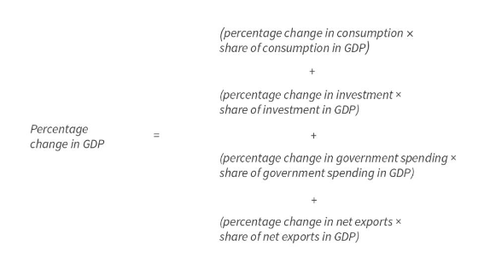
Components of GDP growth
Each component’s contribution to GDP growth is
a function of its size, and
its own growth.

Slide 46
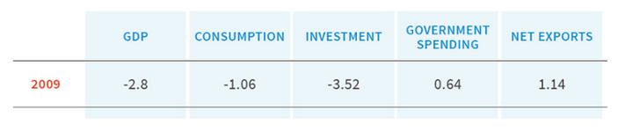
Components of GDP growth
During the GFC, US growth was much more influenced by the decline in investment.

Slide 47
NZ Recession
Expenditure | 1990 | 1991 | Percent Change
GDP | $76,679m | $75,523m | -1.89%
C | $45,548m | $45,543m | -0.01%
I | $16,403m | $12,872m | -21.53%
G | $14,040m | $14,071m | 0.22%
NX | $648m | $2,747m | +299.27%
In 1990-91 NZ went into a recession.
The largest influence was the drop in Investment.
A significant increase in exports stopped the recession from getting worse.

Slide 48
GDP changes
The NZ Government increases the unemployment benefit by $20 per week, and spends an extra $10m on this benefit in 2020.
  No change- this is a transfer payment from some households to another.
A young family builds a house worth $300,000.
  Investment, thus GDP, increases by $300,000
A person purchases $50,000 worth of shares from an NZ company
  No change. Financial assets are not an investment.
How would NZ GDP change in these examples?

Slide 49
Shocks
04
How households cope with fluctuations

Slide 50
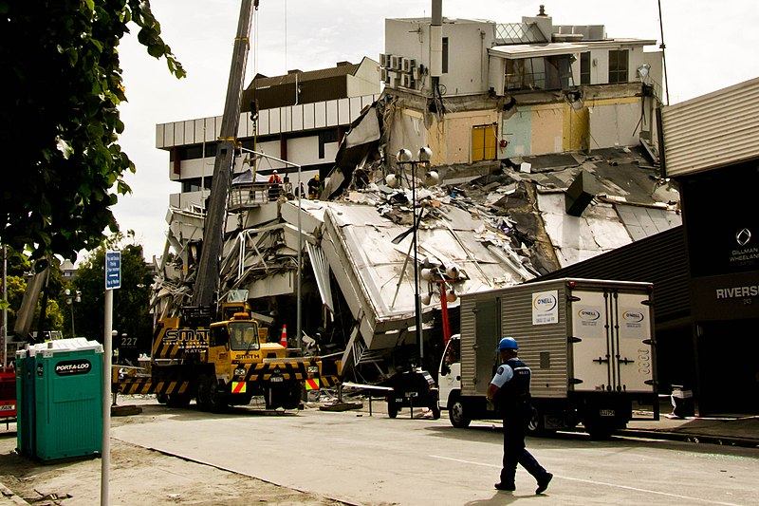
Shocks
Households and economies are subject to shocks.
In NZ two important internal shocks are earthquakes and droughts.

Slide 51
Shocks
Household Shocks
The shock (good or bad fortune) strikes the household.
Economy-wide shocks
The shock (good or bad fortune) strikes the entire economy.
Shocks are unexpected (exogenous) events which cause GDP to fluctuate.
There are two types of shocks

Slide 52
Household Shocks
Self-insurance
Draw down savings or
Borrow money to maintain consumption
Co-insurance
More support from friends, whānau or Government.
E.g. Unemployment benefits or Earthquake Commission in NZ
People use two strategies to deal with shocks.
These draw on evidence that households prefer to smooth their consumption, and are (to a degree) altruistic.

Slide 53
The Natural Hazards Commission – Toka Tū Ake
NZers pay a levy to the Natural Hazards Commission every year through their insurance policies.
The fund pays out to households affected by natural disasters like earthquakes.

Slide 54
Economy-wide shocks
Co-insurance is less effective.
The shock tends to hit everyone at same time.
Conversely Co-insurance is even more important.
E.g. wage-subsidies during Covid19 lockdown in NZ

Slide 55
Consumption smoothing and the aggregate economy
Consumption smoothing is a basic source of stabilisation in an economy.
Limitations to consumption smoothing mean it cannot always stabilise the economy; it may amplify the initial shock.
e.g. credit constraints, weakness of will, limited co-insurance
This helps us understand the business cycle and how to manage it.
Consumption smoothing is an important part of response to shocks.

Slide 56
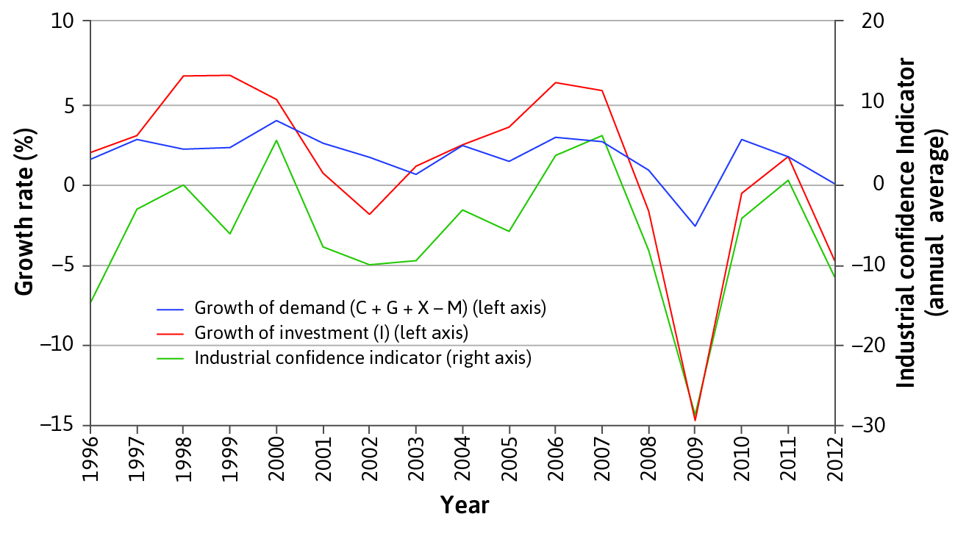
Business confidence
Business confidence coordinates firms to invest at the same time.
Investment is much more volatile than consumption

Slide 57
Other components of GDP
Government spending is less volatile than investment
  (does not depend on business confidence)
Exports depend on demand from other countries,
  so will fluctuate according to the business cycles of major export markets.
Government spending and exports respond differently to shocks.

Slide 58
Measuring the economy
05
Inflation

Slide 59
Inflation: an increase in the general price level in the economy. Usually measured over a year.
Definition

Slide 60
GDP, inflation and unemployment
In periods of
High economic growth, unemployment tends to be low and inflation high
Low economic growth, unemployment tends to be high and inflation low

Slide 61
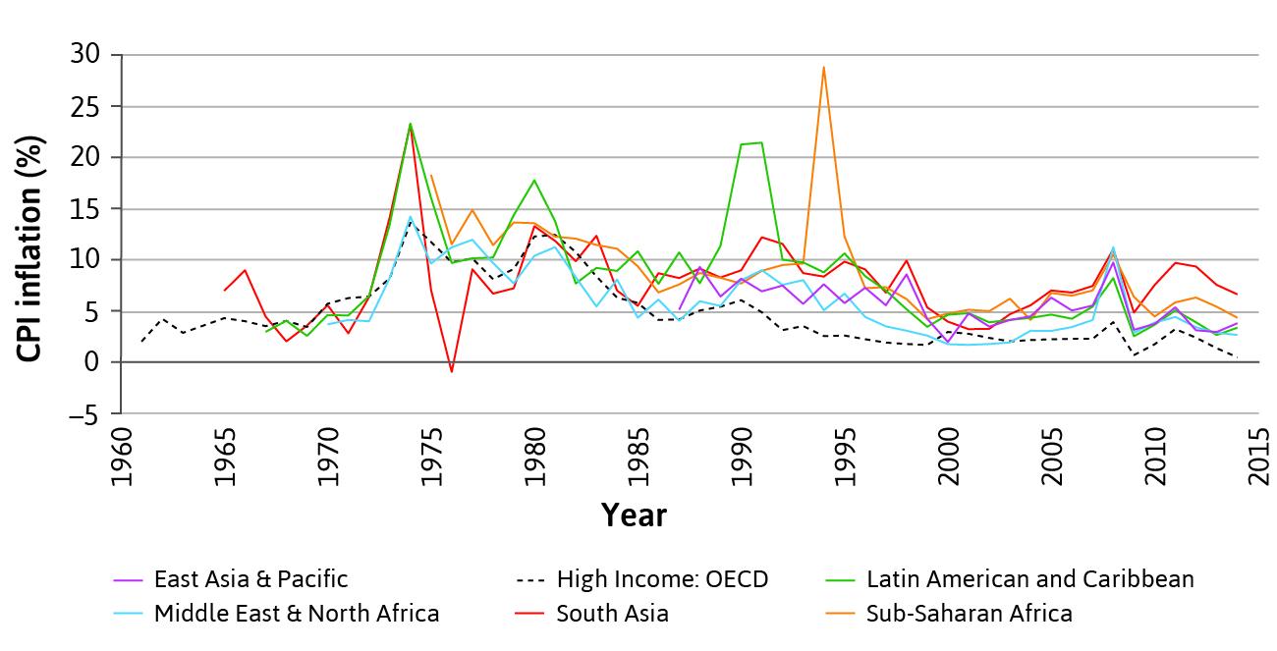
Trends in inflation
Upward spikes in inflation during economic crises
general downward trend since 1970s
inflation tends to be higher in poor than in rich countries

Slide 62
Measuring inflation
The Consumer Price Index (CPI) measures the general level of prices that consumers have to pay for goods and services, including consumption taxes
Based on a representative bundle of consumer goods – “cost of living”
Common measure of inflation = change in CPI
There are two main ways to measure inflation.
The Consumer Price Index
The GDP Deflator

Slide 63

Representative Bundles
Items in the CPI are weighted toward average household.
Households will experience different inflation rates.
E.g. vegetarians or vegans will not be affected by increase in price of beef.

Slide 64
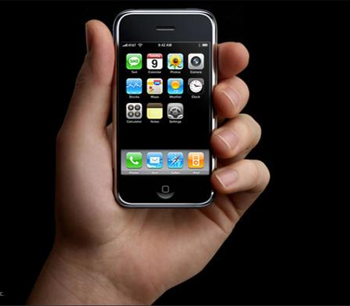
CPI Issues
Quality improvements are hard to measure.
Original iPhone (4.7”) cost $US499 and had 4GB of memory and 2 MP camera.
iPhone 15 (6.1”) costs $NZ1449 with 128 GB of memory, dual SIM and 1 12MP and 1 48MP camera.

Slide 65
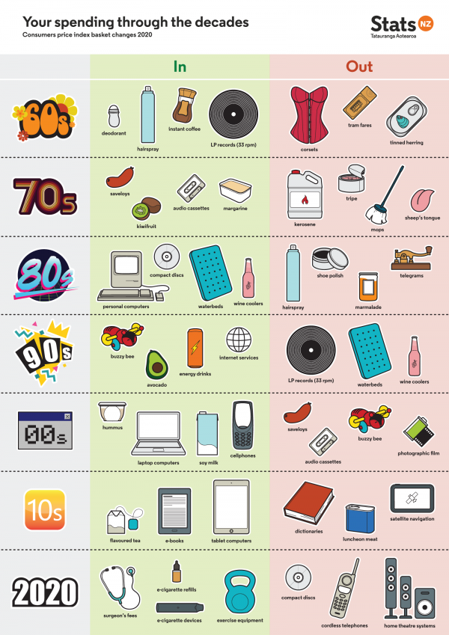
Changes to the goods included in the NZ CPI
  New items have to be added as they become common
  Some items have to be removed when they become insignificant

Slide 66
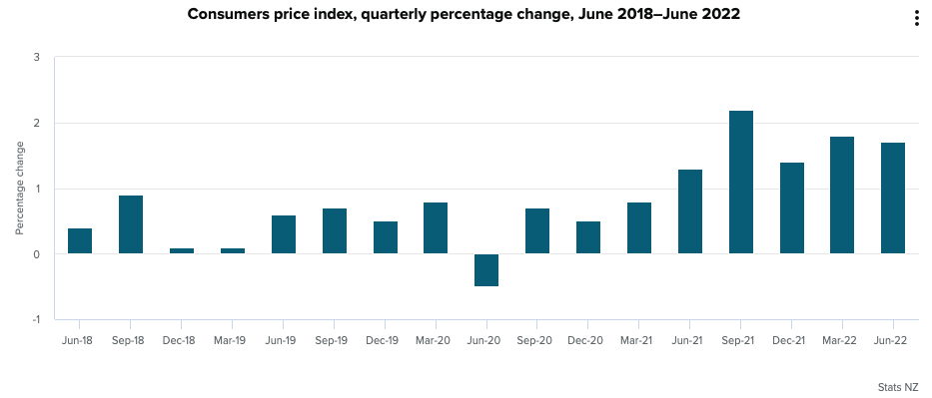
NZ Quarterly CPI

Slide 67
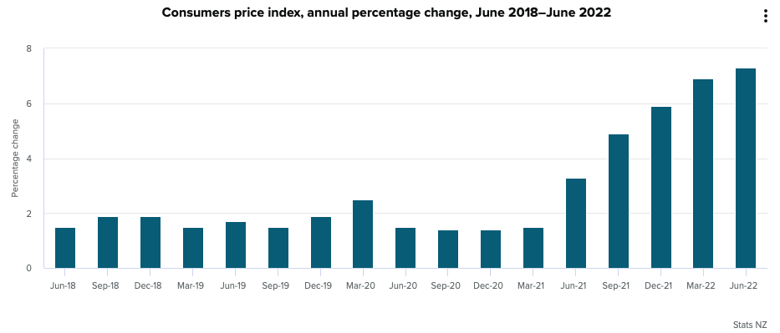
NZ Annual CPI
After many years of low inflation, the CPI is increasing.

Slide 68
Measuring inflation
Tracks prices of components of GDP (C, I, G, NX)
Allows GDP to be compared across countries and over time
GDP deflator = A measure of the level of prices for domestically produced output (ratio of nominal to real GDP)

Slide 69
Price Index
Suppose a typical basket of goods cost a household $120 in 2005
In 2015 the same bundle cost $150.
Let us make the 2005 our base year.
The base index value will be 1000
Price Indices set a fixed base year to compare prices to.

Slide 70
Price Index
The CPI for 2005 (base year) will be
($120/$120)x1000
=1000
The CPI for 2015 will be
($150/$120)x1000
=1250
Divide the cost of the market basket in the year you are interested in
With the cost in the base year.

Slide 71

Any questions?

